Slide 1

ACEC/MA – Accounting & Finance Forum
TAX REFORM TALK
Presented by:
Jackie Weir, CPA (jmweir@bdo.com)
Chad DaGraca, CPA (cdagraca@dgccpa.com)
March 1, 2018

Slide 2


TODAY’S TOPICS
Today we will discuss several key provisions for A&E firms in the Tax Cuts and Jobs Act (HR 1):
  Corporate & Individual Tax Rates
  Alternative Minimum Tax
  Pass-Through Provisions
  Depreciation Changes
  Deductions and Fringe Benefits
  And more!

Slide 3

CORPORATE TAX RATE
    Flat 21% tax rate for all C Corporations, including personal service corporations
      Effective for tax years beginning after December 31, 2017

Slide 4
ACCOUNTING FOR INCOME TAXES
  Due to the timing of the passage of the new tax reform, the 21% federal rate needs to be used when configuring your deferred tax assets and deferred tax liabilities for 2017
  The decrease in the effective federal tax rate will create an income pickup for companies with an overall deferred tax liability
  Management should discuss impact to stock price

Slide 5

CORPORATE ALTERNATIVE MINIMUM TAX
    Corporate alternative minimum tax has been repealed
    Unused minimum tax credits are refundable for tax years 2018-2021
      Credit equal to 50% (100% for 2021) of the excess of the minimum tax credit for the year, over the amount allowable for the year against regular tax liability

Slide 6
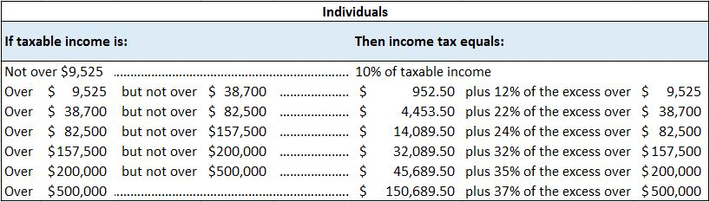
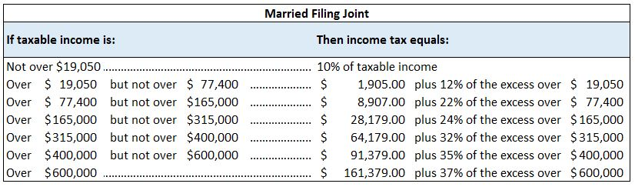
INDIVIDUAL INCOME TAX RATES
  New rates effective for tax years beginning after December 31, 2017, and before January 1, 2026
  No change to capital gain rates on qualified dividends, long-term capital gains, unrecaptured section 1250 gains, collectibles, etc.

Slide 7
PASS-THROUGH DEDUCTION
  Also known as the Qualified Business Income (QBI) deduction
  Effective for tax years beginning after December 31, 2017, and set to expire after December 31, 2025
  A below-the-line deduction for noncorporate taxpayers with domestic qualified business income from a partnership, S Corporation, or sole proprietorship
  Generally, the QBI deduction is the lesser of:
    The combined QBI deduction for each trade or business; or
    20% of the excess of taxable income over the sum of any net capital gain

Slide 8
PASS-THROUGH DEDUCTION
  If a taxpayer’s taxable income is less than or equal to $157,500 ($315,000 for MFJ), then the deduction for each trade or business is 20% of QBI
  If a taxpayer’s taxable income is greater than $157,500 ($315,000 for a joint return) but less than $207,500 ($415,000 for a joint return), then a limitation based on W-2 wages and depreciable property begins to phase in.
  If a taxpayer’s taxable income is greater than $207,500 ($415,000 for a joint return), then the limitation based on W-2 wages and depreciable property is fully phased-in.

Slide 9
PASS-THROUGH DEDUCTION
  When the limitation based on W-2 wages and depreciable property is fully phased in at taxable income levels of $207,500 for single filers and $415,000 for joint filers, then the deductible amount is the lesser of:
    20% of the taxpayer’s qualified business income from the trade or business; or
    The greater of:
      50% of W-2 wages of the trade or business
      The sum of 25% of the W-2 wages of the trade or business, plus 2.5% of the unadjusted basis immediately after acquisition of all qualified property of the trade or business

Slide 10
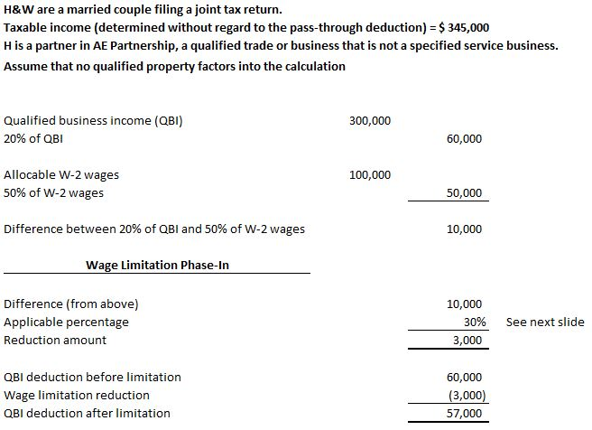
PASS-THROUGH DEDUCTION EXAMPLE

Slide 11
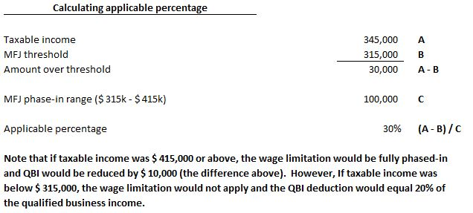
PASS-THROUGH DEDUCTION EXAMPLE

Slide 12

PASS-THROUGH ENTITIES
  S Corporation Conversions to C Corporations
  Eligible terminated S corporation is any C corporation:
      Which was an S corporation on December 21, 2017;
      Which during the two-year period beginning on December 22, 2017 revokes its election; and
      The owners of the stock of which, determined on the date of revocation, are the same owners (and in identical proportions) as on December 22, 2017

Slide 13
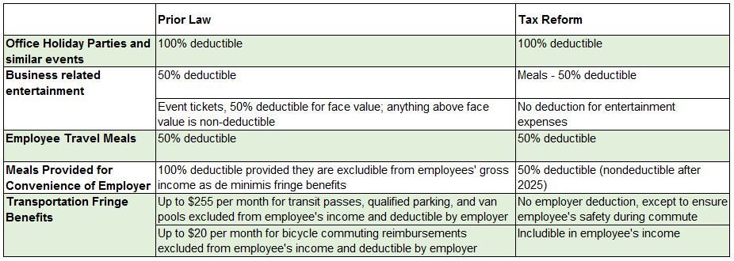
M&E and Transportation Benefits

Slide 14

Moving expense reimbursements
  The exclusion for the qualified moving expense reimbursement has been suspended for tax years 2018 through 2025
  Employers are required to report any payments or reimbursements made after 2017 and before 2026 of employee moving expenses as wages subject to income tax and employment tax withholding

Slide 15

BUSINESS DEDUCTIONS
  Domestic Production Activities Deduction
REPEALED
    A&E companies could take this deduction on services performed in the U.S. in connection with real property construction
(Terminated)

Slide 16
BUSINESS DEDUCTIONS
  Net Operating Losses (NOLs)
    Effective for losses arising after December 31, 2017, NOL deduction for a tax year is limited to the lessor of:
      The aggregate of net operating loss carryovers to the tax year, plus NOL carrybacks to the tax year (from losses incurred before 2018); or
      80 percent of taxable income computed for the tax year without regard to the NOL deduction allowed for the tax year
    80 percent limitation not applicable to losses incurred before January 1, 2018
    Carryback is generally eliminated and carryforwards are allowed indefinitely

Slide 17
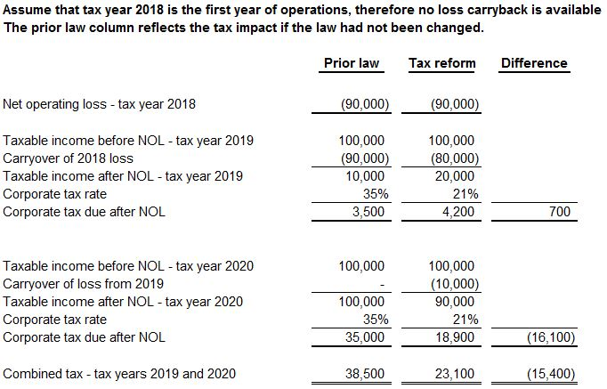
NET OPERATING LOSSES EXAMPLE

Slide 18
EXCESS BUSINESS LOSS LIMITATION
  An excess business loss is the excess, if any, of:
    The taxpayer’s aggregate deductions from the taxpayer’s trade or businesses; over
    The sum of the taxpayer’s aggregate gross income or gain from such trade or businesses, plus $250,000 ($500,000 for joint return) adjusted annually for inflation
  Excess business losses are treated as a net operating loss (NOL) carryover to the following year
  Passive activity rules apply before the application of the excess business loss rules

Slide 19
Business Deductions
  Limitation of Deduction of Business Interest
  The deduction of business interest is limited to 30 percent of adjusted taxable income
    Exceptions:
      For small business with average gross receipts of $25 million or less over the preceding three tax years. Does not apply to tax shelters
      Taxpayers may elect to exclude from the limitation any real property trade or business but must use ADS recovery periods for real property which are longer than MACRS
  Interest not deductible in any given year may carried forward indefinitely
    Restrictions for partnerships and S corporations

Slide 20
Business Deductions
  Limitation of Deduction of Business Interest
  Limitation is the sum of:
    Business interest income of the taxpayer for the tax year
    30 percent of the taxpayer’s adjusted taxable income for the year
  Adjusted taxable income –
    Taxpayers regular taxable income computed without regard to:
      Income not allocable to a trade or business
      Net business interest
      NOL deduction
      The 20-percent pass-through deduction
      Depreciation, amortization, or depletion

Slide 21

Business Deductions
  Limitation of Deduction of Business Interest
  Restrictions for partnerships and S corporations
    Interest limitation applies at entity level
    Any disallowed interest is allocated to each partner or shareholder as excess business interest

Slide 22
Business Deductions
  Limitation of Deduction of Business Interest
  Example
  ABC Inc. is a C corporation. Assume it has $30,000 of taxable income, interest expense of $20,000, and depreciation deductions of $5,000
  ABC Inc.’s adjusted taxable income is equal to $55,000 ($30,000 of taxable income, interest expense of $20,000 plus $5,000 of depreciation)
  ABC Inc.’s deduction for business interest would be limited to $16,500 (30% of $55,000)
  The remaining $3,500 would be carried forward

Slide 23
Depreciation Changes
  Section 179 Expensing of Depreciable Assets
    Dollar limitation is increased to $1,000,000 and the investment limitation is $2.5 million
    Qualified real property expensing expanded to include:
      Qualified improvement property; and
      Any of the following improvements to nonresidential real property that are placed in service after the nonresidential real property was first placed in service:
        Roofs
        Heating, ventilation, and air-conditioning property
        Fire protection and alarm systems
        Security systems

Slide 24
Depreciation Changes
  Section 179 Expensing of Depreciable Assets
  $25,000 limit on certain heavy vehicles
    Will be adjusted for inflation in tax years beginning after 2018
    The limit applies to a sport utility vehicle, a truck with an interior cargo bed length less than six feet, or a van that seats fewer than 10 persons behind the driver’s seat, and has a gross vehicle weight rating in excess of 6,000 pounds but not more than 14,000 pounds

Slide 25
Depreciation Changes
  Additional Depreciation Allowance (Bonus Depreciation)
    Rate is increased to 100-percent for qualified property acquired AND placed in service after September 27, 2017 and before January 1, 2023. This amount will be reduced by 20-percent per calendar year for tax years beginning after 2022
    Taxpayer may elect to apply 50-percent rate instead for first tax year ending after September 27, 2017

Slide 26
Depreciation Changes
  Additional Depreciation Allowance (Bonus Depreciation)
  Qualifying property
    Allowance available for new or used property that is:
      Depreciable under MACRS and has a recovery period of 20 years or less
      Computer software depreciable over three years under Code Sec. 167(f)
      Note: Used property that is new to the taxpayer now qualifies

Slide 27
Depreciation Changes
  Recovery Periods for MACRS Real Property
    Qualified improvement property is assigned a 15-year recovery period
    Note: Assuming 15 year recovery period intended by congress but final bill inadvertently omits the provision
    Property classes for 15 year leasehold improvement property

Slide 28

INCOME, EXCLUSIONS, ETC.
  Like-Kind Exchanges
    Now only allowed for real property
    Auto trade-ins are now taxable

Slide 29
Paid Family & Medical Leave Credit
  For tax years beginning after December 31, 2017 and before January 1, 2020, an eligible employer is allowed a general business credit for wages paid to eligible employees on leave under the FMLA
  The credit is equal to 12.5% of the amount of wages paid during the FMLA period if the payments are 50% of the wages normally paid to the employee, and the credit increases by 0.25 percentage points, up to 25%, for each percentage point the rate of payment to an employee exceeds 50%
  The maximum amount of wages that may be taken into account for any employee is 12 weeks

Slide 30

ODDS & ENDS
  IC-DISC
    Retained by tax reform bill but weakened by tax rate cuts
  Section 179D
    Energy deduction extended for projects placed in service by December 31, 2017

Slide 31

A&E FOCUS – TAX REFORM TALK
Questions?

